Slide 1

BANKING BOT
`
Akshaya Bhalikha Dhanasekaran – 100936892
Regunanthan Kumaravel - 100920917
Charan Anugula Ramesh - 100943128
Manikandan Ganesan – 100921793
Narendranathan Veeraragavan - 10088894

Slide 2

Project Functionalities
User Authentication
Banking related functionalities for example
Balance Check
Investment product Queries
Everyday banking queries
Chatbot for 24*7 support

Slide 3
Stages Workflow
Getting Ready
Data Collection and Prep.
Front-End Blueprint.
Creating the Front End.
Making It Work
Back-End Structure.
Back-End Building.
Adding the Brain.
Getting It Just Right
Integrate and Test.

Slide 4
Basic Features
1. User Intent Recognition:
Classify user messages into categories like accounts, loans, credit cards, etc.
Understand and respond to basic inquiries.
2. FAQ Handling:
Pre-loaded answers to frequently asked questions.
Quick retrieval and accurate response to common queries.
3. Text-based Interaction:
Basic text parsing and understanding.
Simple text-based responses to user queries.
4. Rule-based Responses:
Defined rules for certain keywords or phrases.
Scripted responses based on identified user intent.

Slide 5



AI FEATURES
Voice Recognition and Synthesis: Voice-enabled interactions for users preferring speech over text. Convert text responses to natural-sounding voice. Available separately in a Gradio app. Couldn’t integrate it with chatbot.
Sentiment Analysis: Detect user frustration or satisfaction. Escalate conversations to human agents when negative sentiment is detected.
Natural Language Understanding (NLU): Deep learning models to understand context, slang, and typos. Capability to handle complex and varied user queries.

Slide 6
Tech Stack
Front End – React, HTML, JS, CSS
Backend – Node JS, Express JS, Python, Flask
Database – MangoDB
AI Components – Langchain OpenAI, Huggingface, Sklearn
Deployment – AWS EC2 Instance

Slide 7
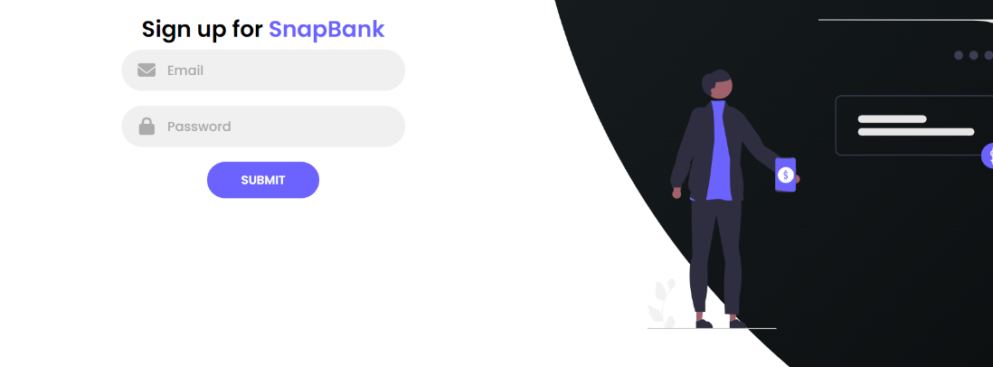
App Screenshots
1. Signup Page
User Registration: Streamlined signup process for new users to create their accounts and start banking with SnapBank.
Personalized Experience: Tailored registration forms ensure we gather essential information to personalize your banking experience.
Security Measures: Robust validation and encryption protocols safeguard your data during the signup process, ensuring your information remains secure.

Slide 8
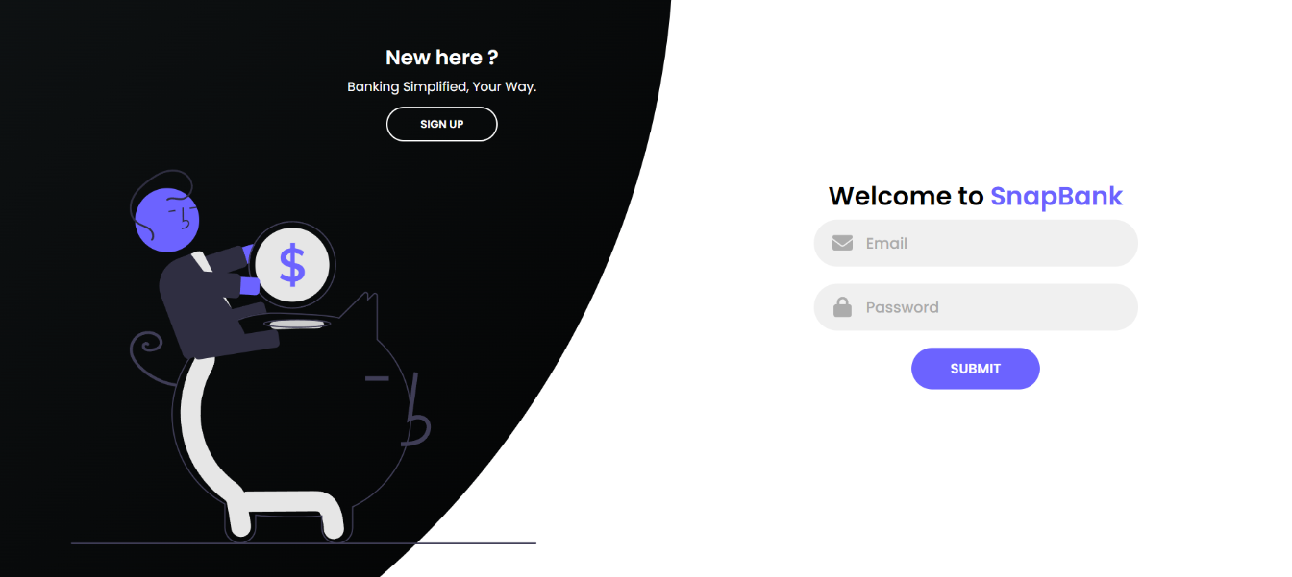
App Screenshots
2. Login Page
Secure login functionality to ensure data privacy and user-specific settings

Slide 9
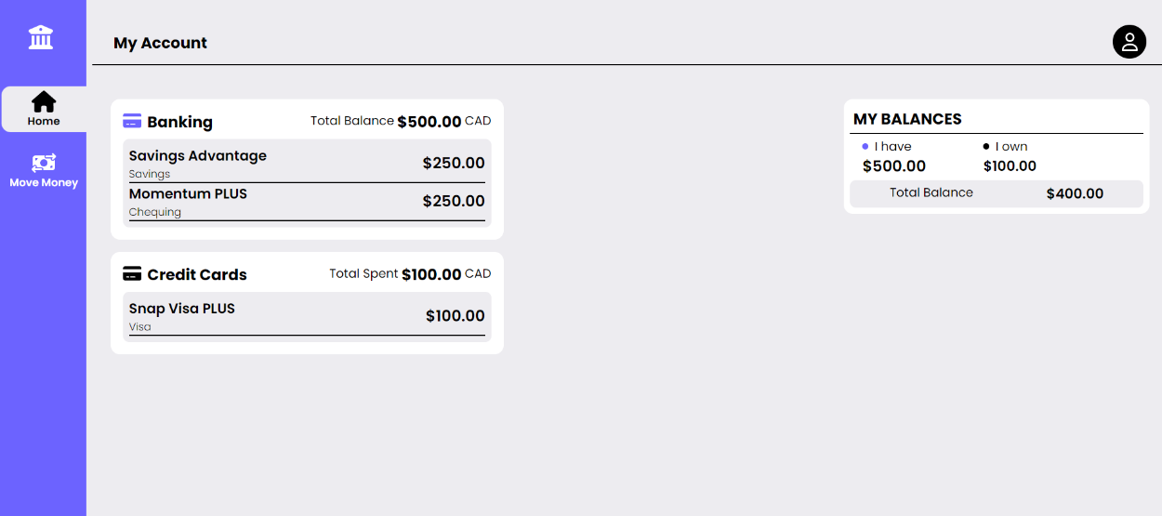
App Screenshots
3. User Dashboard: Central hub for navigation within the application, displaying relevant information and option

Slide 10
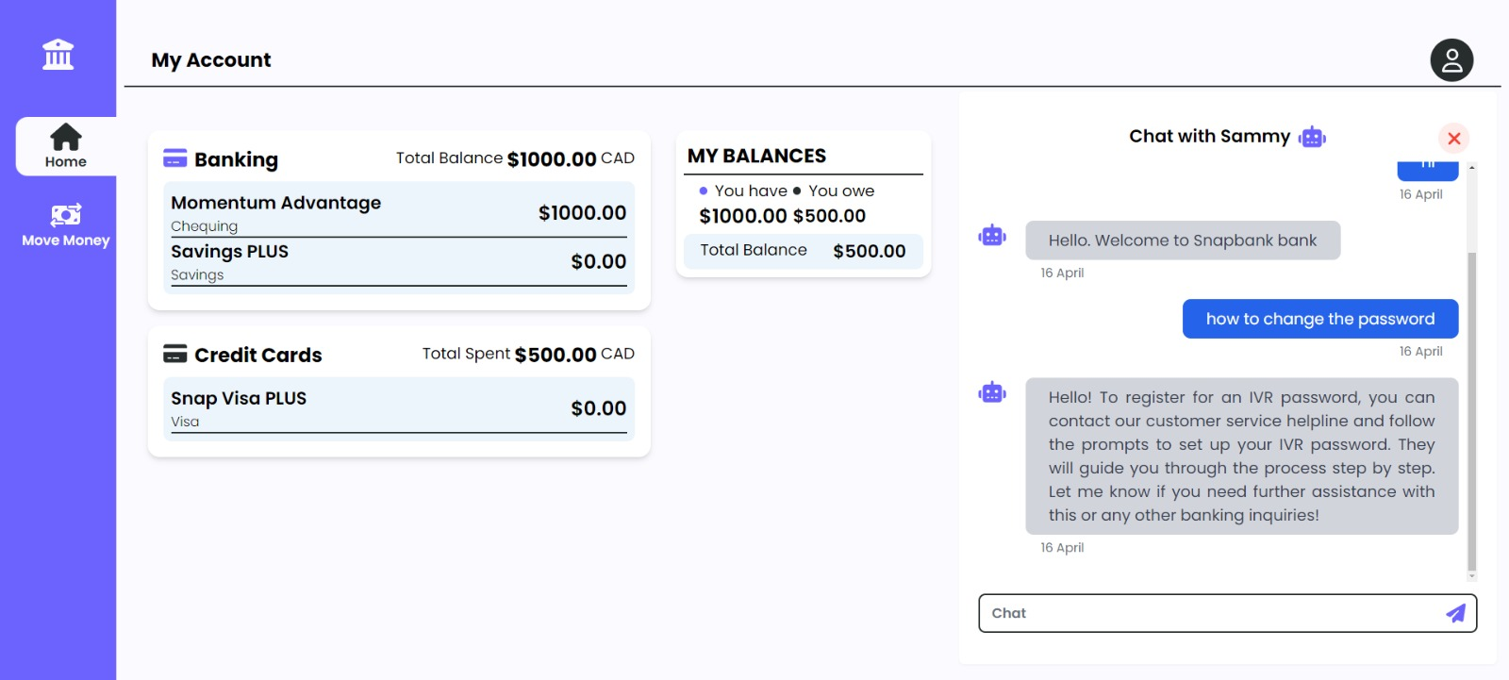
App Screenshots
4. ChatBot(Sammy) :Our banking chatbot providing real-time assistance for account inquiries and transactions, with RAG-based feedback and intelligent responses powered by LLM..

Slide 11

THANK YOU

